Slide 1

Stock Market Prediction using Sentiment Analysis and LSTM
EAS 508 Group Number 2
Group Members :
Shreya Joshi
Jhanvi Kasundra
Rajiv Nagesh
Ishansh Sahni
Adithya Kuruba

Slide 2
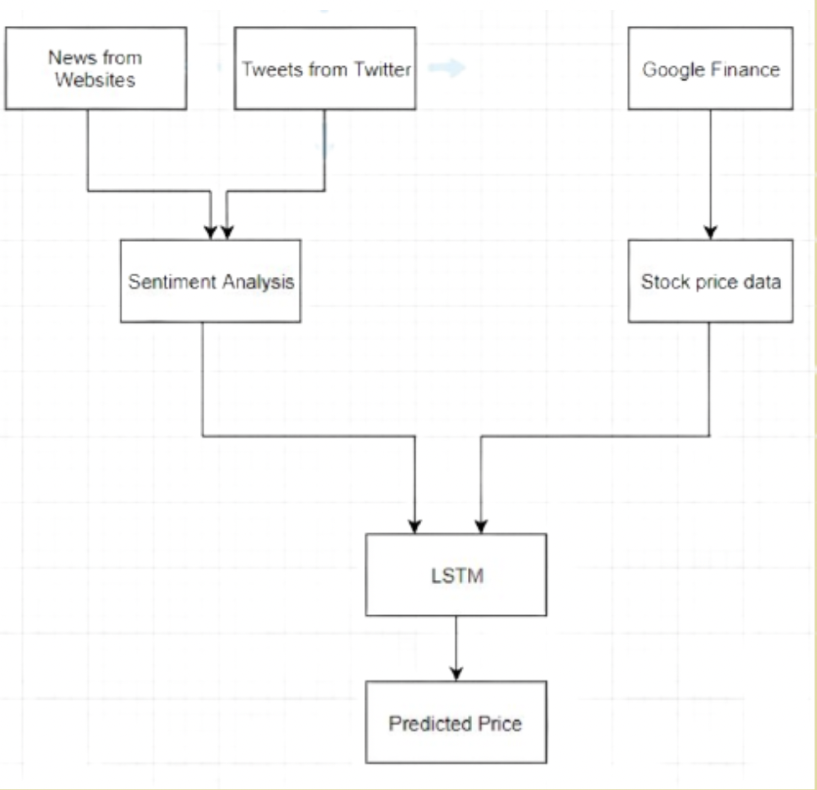
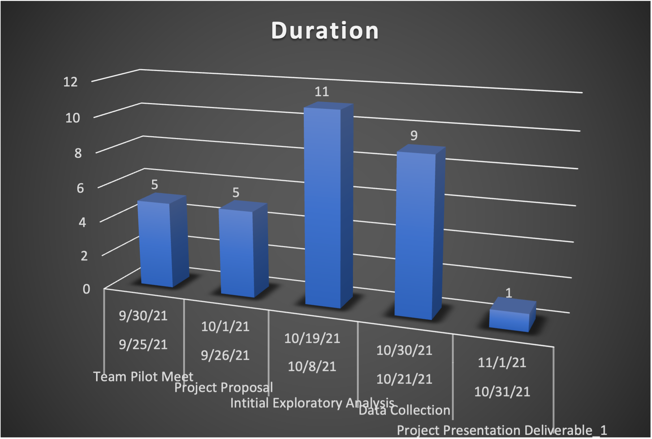
Problem Scope:
This projects aim to traverse and build upon existing firms of stock predictions by the inculcation of LSTM core conceptualization.
Furthermore, we can put light on the two existing modules of stock market analysis and i.e. The statistical and the machine learning approaches.
Creation of a hybrid model by overlapping both methodologies proves to be a crucial aspect moving forward as each one of them sets forth numerous opportunities to take advantage of.
Fig. 1 Methodology

